Slide 1
Exploratory Data Analysis (EDA) - Sat and Drug
By Pataree (Gib) Ngamwongwan

Slide 2
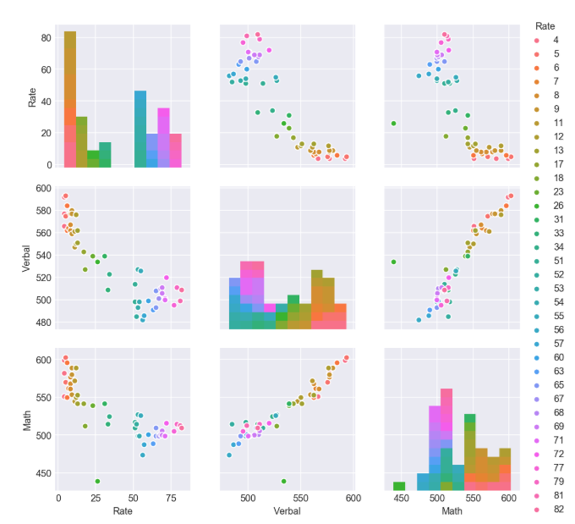
Sat pair Plot
Notes:
Verbal and Maths have positive relationship.
Rate have negative relationship with both Verbal and Maths

Slide 3
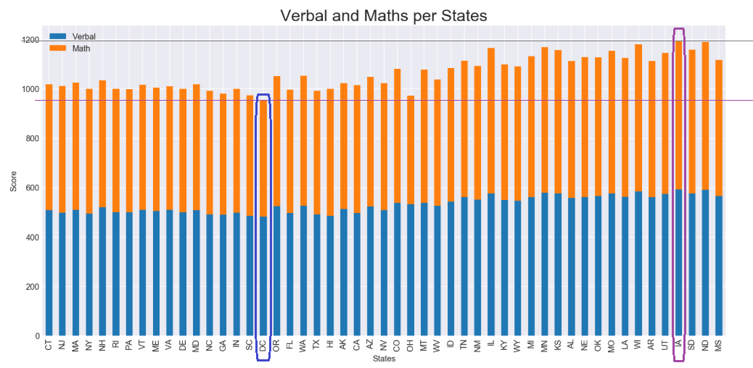
SAT Highest and lowest score by state
Notes:
DC has lowest score and IA has highest score based on the stack bar

Slide 4
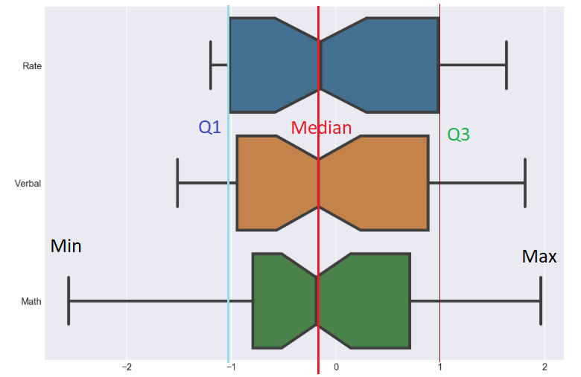
SAT Normalised
Notes:
Using box plot to compare and show the IQR, min, max and median values

Slide 5
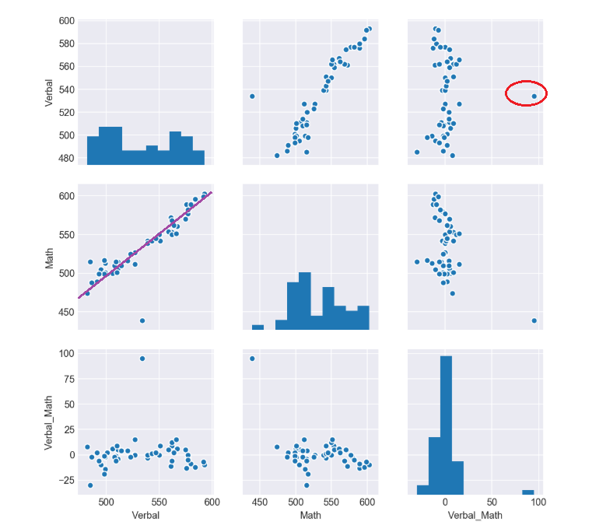
SAT Pair Plot
Notes:
See both distribution of single variables and relationships between two variables

Slide 6
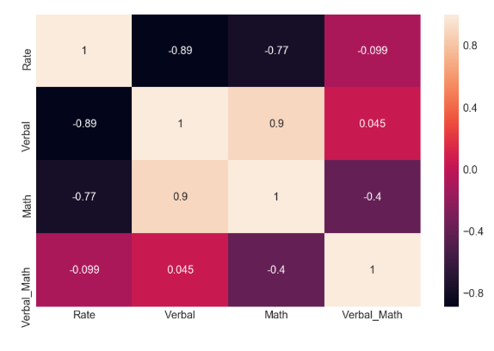
Heat map showing high correlations

Slide 7
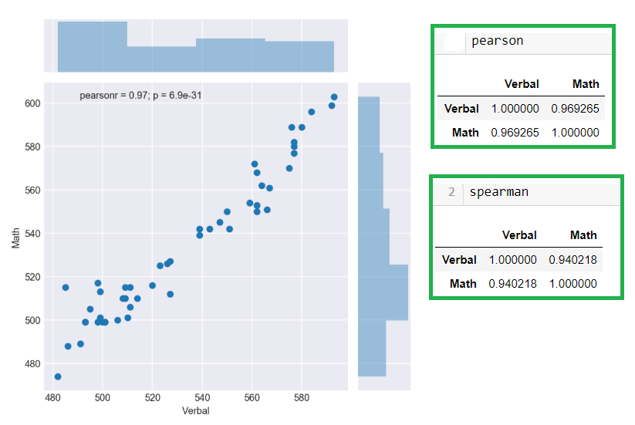
SAT Correlation
Notes:
Confirm Positive Relationship between Verbal and Maths using Pearson and Spearman Coefficient

Slide 8
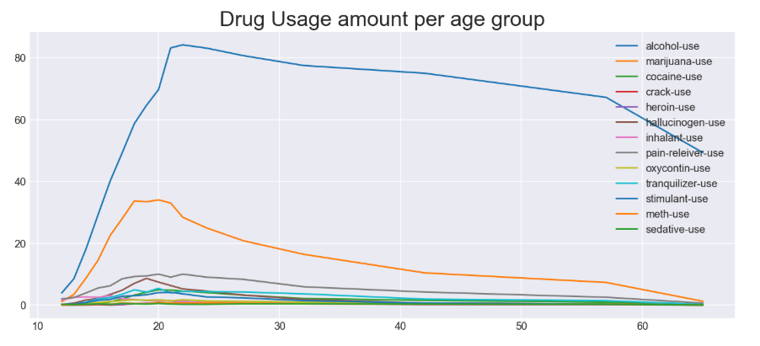
DRUG Usage per age Group

Slide 9
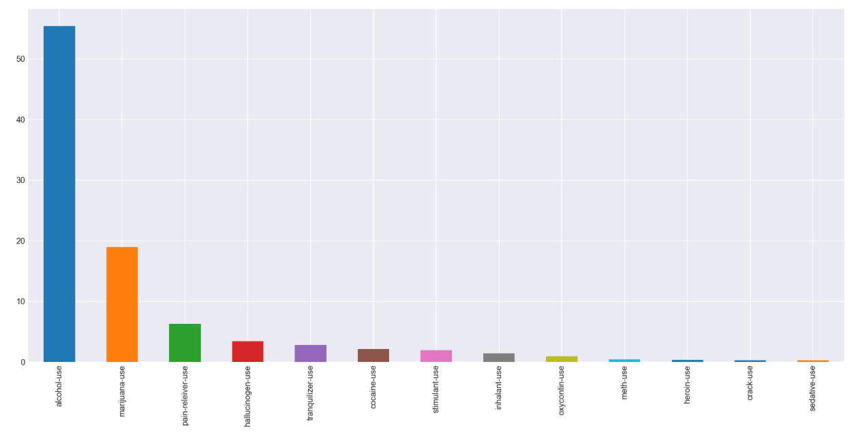
DRUG MEAN USAGE BY TYPE

Slide 10
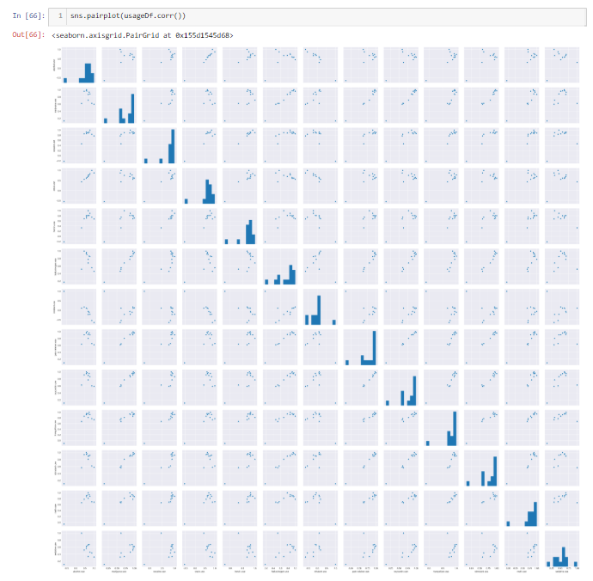
Notes:
USAGE Correlation

Slide 11
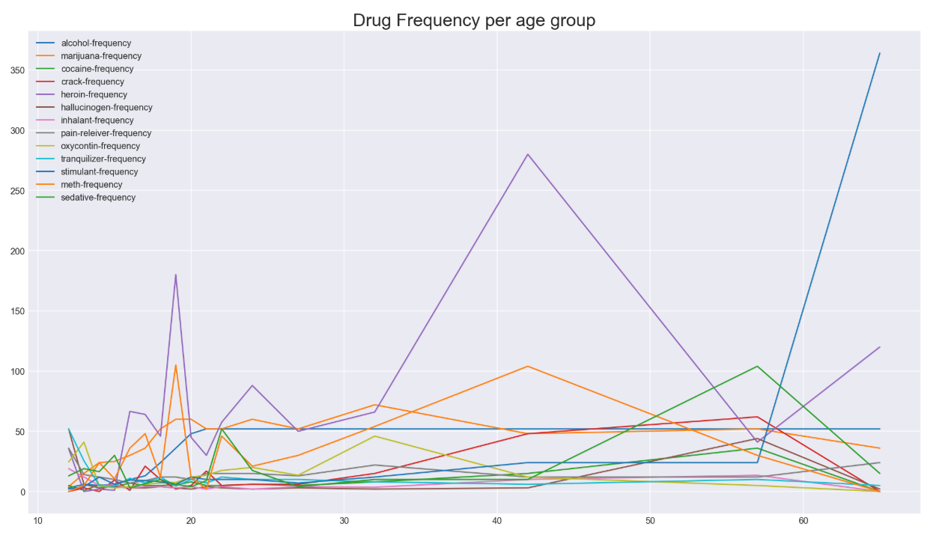
DRUG FREQUENCY

Slide 12
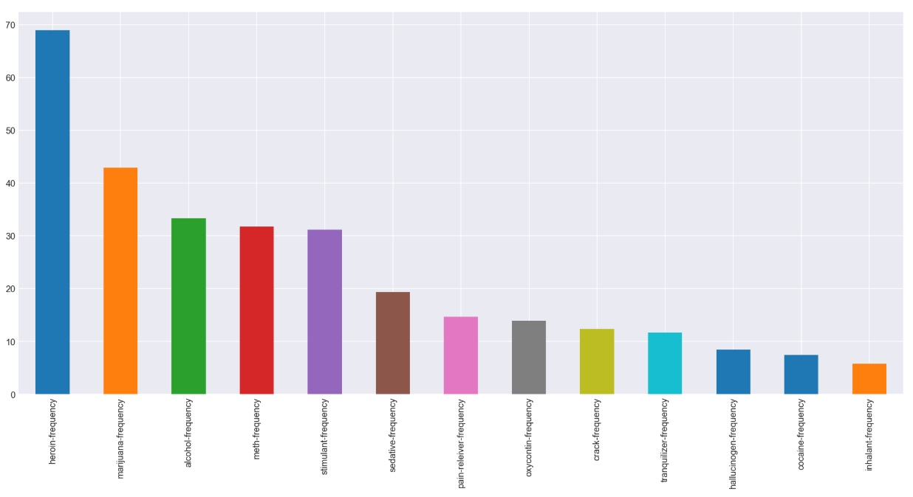
DRUG FREQUENCY MEAN by TYPE

Slide 13
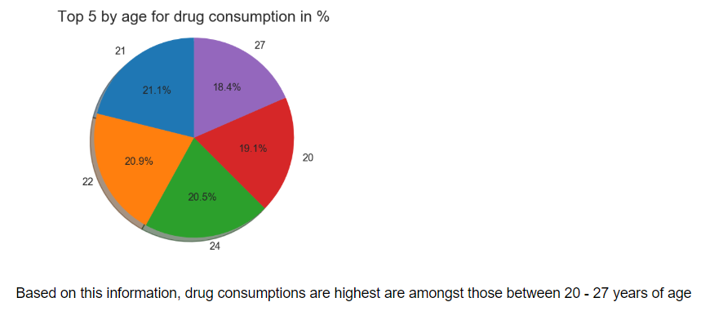
Top 5 drug consumption by age group

Slide 14
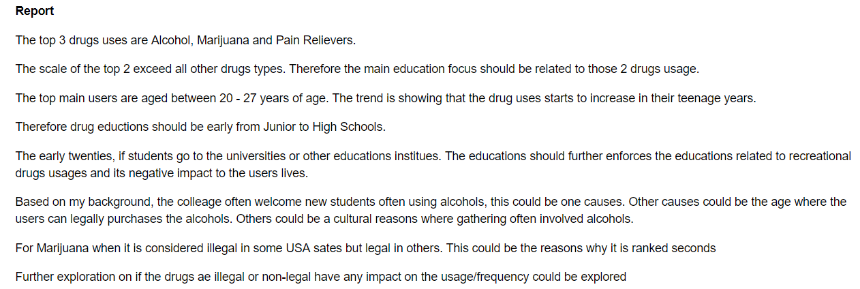

Slide 15
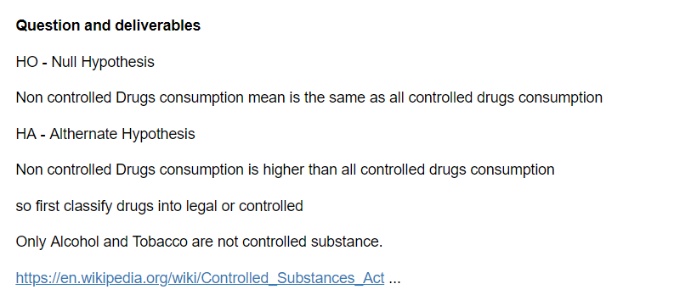

Slide 16
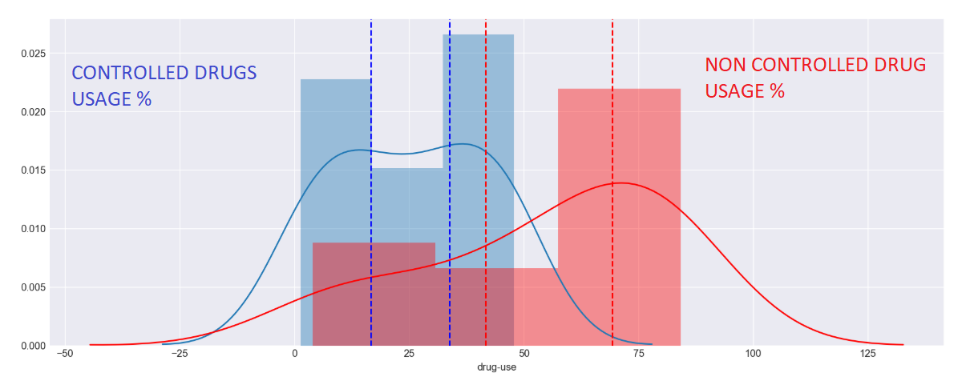

Slide 17
ReportS AND FINDINGS
Control usage mean (Prescription and Illegal Drugs) is 25.14117647058823 Non-Control (Alcohol) usage mean is 55.42941176470588 T_Stat.statistic is 3.94701673 P Value is 0.00020318 (for each tail)
We reject our null hypothesis and conclude that the true mean of Non-Control (in this case only alcohol) Drug Usage value is the same as the mean of All (12 different types of drugs combine) Control Drug Usage value.
This highlight how effective control drug usage compare to the non-control drug.

